Slide 1
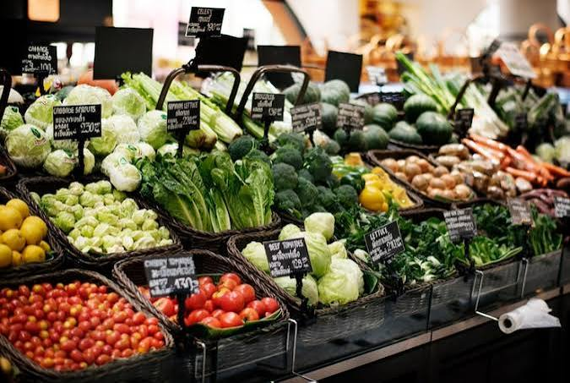
StoreIQ AI
Inventory forecasting and smart billing for supermarket chains
Team 16 · Smart Stack Sentinels · SSS-16 · CODEGNAN

Slide 2






The problem on the shelf
Reorders by experience
Fast movers run out, slow movers expire
Reports only at month end
Head office reacts weeks too late
A separate stock system per store
No view of total stock across 8 stores
Expiry found by manual checks
Expired items sit on shelves

Slide 3





One platform for billing, stock and AI
Billing that updates stock
Every sale adjusts inventory instantly
Purchasing and transfers
Orders, receiving, inter-store moves
AI forecasting
Demand per store, alerts before stock-outs
GenAI assistant
Ask sales questions in plain English

Slide 4



Four roles, one system
Cashier
Store Manager
Regional Manager
Admin
Billing and returns at the counter
Stock, purchase orders, store performance
Compares stores, approves stock transfers
Products, stores, suppliers and users

Slide 5






Core features
Secure login
Product master
Smart billing
Purchasing
Role-based access
Categories, batches, expiry
Automatic stock updates
Purchase orders and receiving
Stock transfers
Suppliers
Stock alerts
Customer history
Between stores, with approval
Management with lead times
Low stock and near expiry
Purchases of regular customers

Slide 6


AI and GenAI inside the workflow
AI
GenAI
Demand forecasting
Ask your sales data
Per-store forecasts drive reorder suggestions that cut stock-outs and expiry losses.
Managers ask questions in plain English and get answers with figures.
Smart bundles
Weekly store reports
Buying-pattern analysis suggests bundles that move near-expiry stock.
Narrative report generated automatically for every store.

Slide 7
Architecture at a glance
Web app Cashier · Store Manager · Regional Manager · Admin
REST API Token login · role-based access · validation
Billing & stock
Purchasing & transfers
AI: forecast & bundles
GenAI: Q&A & reports
Database products · batches · stock · sales · suppliers | synthetic or public data only

Slide 8
Admin dashboard preview
₹4.8 L
23
11
91%
Today's sales
Low-stock items
Near-expiry batches
Forecast accuracy
Illustrative synthetic data

Slide 9




Proposed tech stack
Frontend
Backend
Database
React
Flask
PostgreSQL
AI / ML
GenAI
Deployment
AI/ML logic Pandas Data processing and analysis
LLM API:Gemini, OpenAI
Docker, cloud hosting
Suggested stack; swap in your hackathon's required technologies.

Slide 10
Never run out. Never expire.
Smart Stack Sentinels · Team 16 · Thank you

